Slide 1



AI Powered Smart Email Classifier for Enterprises
Automating Inbox Intelligence with Machine Learning
Guided by: Mousami Shrivastava

Slide 2




The Problem Statement
(Current Challenges)
Information Overhead
Delayed Response Times
Managing hundreds of thousands of customer and internal emails manually is inefficient and costly.
Critical Complaints and support tickets get buried under general inquiries or spam.
Inconsistent Routing
Lack of Actionable Analytics
Manual triage leads to human error, resulting in emails forwarded to the wrong departments.
No real-time visibility into what customers are emailing about most frequently.

Slide 3




The Solution
(AI-Powered Triage)
Automated Intelligence
Instant Categorization
Emails evaluated in milliseconds and routed to correct department.
AI model trained on over 2 lakhs+ historical emails.
Spam Elimination
Interactive Application
Identifies and isolates unsolicited emails to keep queues clean.
User-friendly dashboard for managers to monitor email traffic and model confidence.

Slide 4
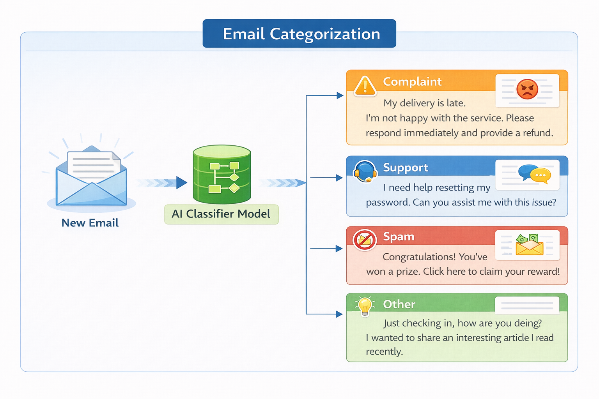
The 5 Core Categories & Actions
Complaint (High Priority)
Escalate immediately to customer service
Support (High Priority)
Route to technical teams
Feedback (Medium Priority)
Analyze for product improvements
Other (Low Priority)
Route to standard queue
Spam (Low Priority)
Auto-archive / Delete

Slide 5
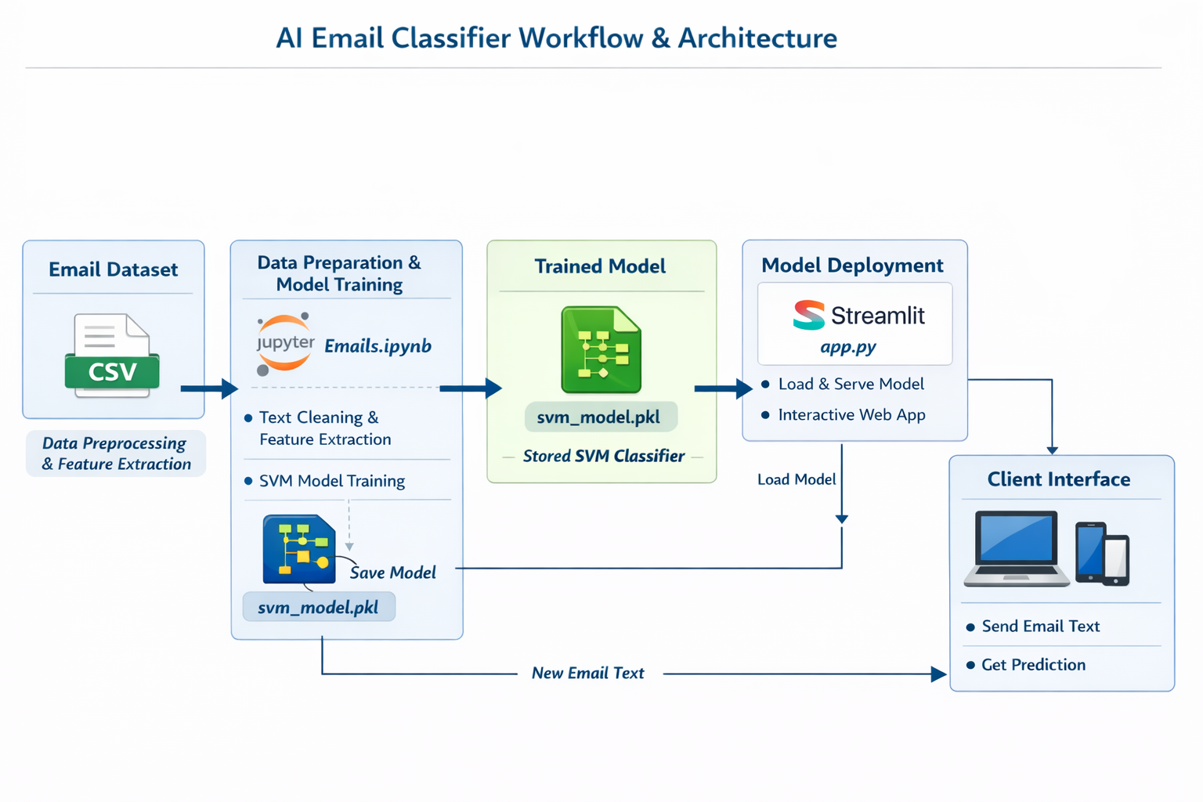





Overall System Architecture
Email Dataset (CSV)
Raw email data input source
Jupyter Notebook
Text cleaning and feature extraction
SVM Model Training
Optimization and classification learning
Model Storage
Saved as svm_model.pkl
Streamlit Deployment
Interactive web app for predictions

Slide 6




The AI Engine
(Under the Hood)
Model Architecture
Massive Training Dataset
Linear SVM with TF-IDF vectorization
Perfectly balanced dataset
8,000 features with 3-word combinations
2 lakh+ emails trained and evaluated
Industry-Leading Accuracy
Flawless Precision
Overall classification performance
Support and Spam categories
99.22% accuracy achieved
Perfect 100% F1-score

Slide 7



Explainable AI
(Trusting the Model)
Transparent Decision Making
Keyword Extraction
Confidence Scores
The system doesn't act as a black box
Algorithm highlights exact driving words
Every prediction includes probability
Example Keywords
Example Prediction
Clear visibility into classification logic
98.5%
crash
failed
login
Confident it's a Complaint

Slide 8







Interactive Analytics Dashboard
Real-time Metrics
Deep-Dive Analytics
Volume Tracking
Analyzes most influential keywords across categories
12,458
Total Emails Today
Complaint: delay, late, issue
30-Day Interactive Charts
1,892
Spam Blocked
Daily email volume trends and category distribution visualization
Support: reset, password, login
96.8%
Feedback: great, suggestion, improve
Average Confidence

Slide 9




Business Value & ROI
Massive Time Savings
Improved SLAs
Eliminates thousands of hours of manual triage per year
Faster response times for critical support and angry customers
Data-Driven Insights
Cost Efficiency
Direct insight into customer feedback trends for marketing and product teams
Lightweight deployment structure using Python and Streamlit

Slide 10


API Integration & Deployment Roadmap
Current State
Future Scope
Live & Deployed
Enterprise API Integration
99.22% accuracy achieved
FastAPI model exposure
Streamlit app fully built
Zero Human Intervention
Ready for immediate use
Silent automated background routing
Real-time analytics dashboard
Direct Outlook/Gmail integration

Slide 11

Thank You
Questions? Let's Discuss.

